Slide 1

PROJECT NAME: SMART PARKING
NAME : Punithkumar B A
Department: B.E. Electronics and communication

Slide 2
INNOVATION:
Creating an innovative smart parking system using the Internet of Things (IoT) involves leveraging sensors, connectivity, and data analytics to optimize parking space utilization, enhance user experience, and reduce congestion.
These sensors can detect the presence or absence of vehicles and transmit real-time data to a central server or cloud. Users can access this information through a mobile app or a website to find available parking spaces.
Use IoT data to implement dynamic pricing based on demand.
Link users' accounts to their vehicle and automate payments for parking.
Utilize IoT to monitor the condition of parking equipment such as ticket machines, gates, and sensors. This allows for predictive maintenance, reducing downtime and improving user experience..
In the event of accidents or medical emergencies, the system can automatically alert emergency services and provide precise location data.
Collect and analyze data from IoT sensors to identify trends and patterns.

Slide 3
OBJECTIVES:
Maximizing the use of available parking spaces by efficiently managing their allocation, reducing congestion, and eliminating the need for excessive parking infrastructure.
Increasing the revenue for parking facility operators by implementing dynamic pricing strategies, offering premium services, and reducing revenue leakage due to unauthorized parking.
Improving the security of parking facilities by implementing surveillance systems, real-time alerts for emergencies, and features that deter criminal activities.
Minimizing the traffic congestion and pollution in and around parking facilities by efficiently guiding vehicles to available parking spaces.
Streamline parking operations by automating tasks like ticketing, payments, and enforcement, reducing administrative overhead.
Creating mechanisms for gathering user feedback and continually improving the system based on user suggestions and experiences.

Slide 4
IOT SENSOR DESIGN:
There are several IoT sensors and components that are used in the smart parking system using IoT. Some of them are as follows,
Ultrasonic sensors: Measure distance and are suitable for detecting the presence of vehicles in parking spots.
Infrared sensors: Detect heat signatures and can be used to identify vehicle presence.
Magnetic sensors: Detect changes in magnetic fields when a vehicle is parked.
Optical sensors: Use cameras or image sensors to capture images and analyze them for vehicle detection.

Slide 5
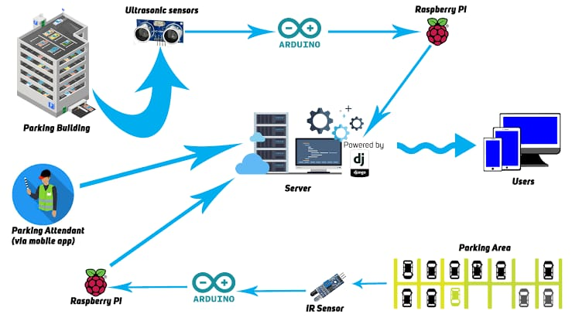






Slide 6
DESIGN FEATURES:
Designing features for a smart parking system involves creating a comprehensive set of functionalities that enhance parking management, user experience, and operational efficiency. Here are some key features to consider when designing a smart parking system:
Real time parking availability
Mobile app integration
Sensors and cameras
Payment integration
Navigation assistance
Energy efficiency
Maintenance alerts
License plate recognition
Scalability
User friendly interface
Remote management

Slide 7
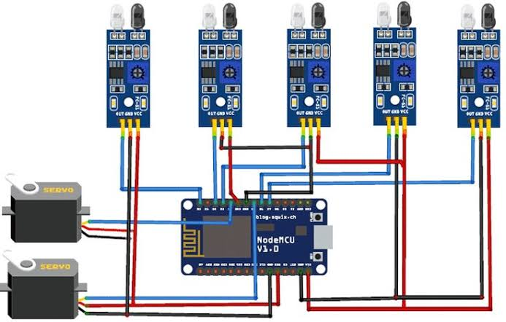
CODE IMPLEMENTATION:
import RPi.GPIO as GPIO
import time
# Set the GPIO pins for the ultrasonic sensor (you may need to adapt these)
TRIG = 23
ECHO = 24
# Set up GPIO mode and pins
GPIO.setmode(GPIO.BCM)
GPIO.setup(TRIG, GPIO.OUT)
GPIO.setup(ECHO, GPIO.IN)
# Function to measure distance using the ultrasonic sensor
def get_distance():
GPIO.output(TRIG, False)
time.sleep(2)
GPIO.output(TRIG, True)
time.sleep(0.00001)

Slide 8
GPIO.output(TRIG, False)
while GPIO.input(ECHO) == 0:
pulse_start = time.time()
while GPIO.input(ECHO) == 1:
pulse_end = time.time()
pulse_duration = pulse_end - pulse_start
distance = pulse_duration * 17150 # Speed of sound = 34300 cm/s
return distance
try:
while True:
distance = get_distance()
if distance < 10: # Adjust this threshold based on your sensor and parking spot
print("Parking spot is occupied.")
# Here, you can trigger actions for an occupied spot (e.g., update a database).
else:
print("Parking spot is vacant.")
# Here, you can trigger actions for a vacant spot (e.g., update a database).
time.sleep(5) # Adjust the interval as needed
except KeyboardInterrupt:
GPIO.cleanup()

Slide 9
CONCLUSION:
Smart parking systems improve the efficiency of parking facilities by providing real-time information about parking spot availability. This reduces the time drivers spend searching for parking spaces, which can lead to reduced traffic congestion and lower emissions . A smart parking system represents a significant technological advancement that can offer numerous benefits to both parking facility operators and users. This technology leverages the Internet of Things (IoT) to optimize parking space management, enhance user experiences, and address the challenges of urban congestion.

Slide 10
THANK YOU

